Slide 1
Security Culture
&
Workflow Based Security Controls
INFORMATION SECURITY MANAGEMENT

Slide 2
Objectives
The students should be able to:
  Define and describe security awareness, security training, security education.
  Apply segregation of duties to information technology with regard to a business.
  Plan allocation of security responsibility, documentation and training.
  Describe good practices for hiring and terminating an employee.

Slide 3
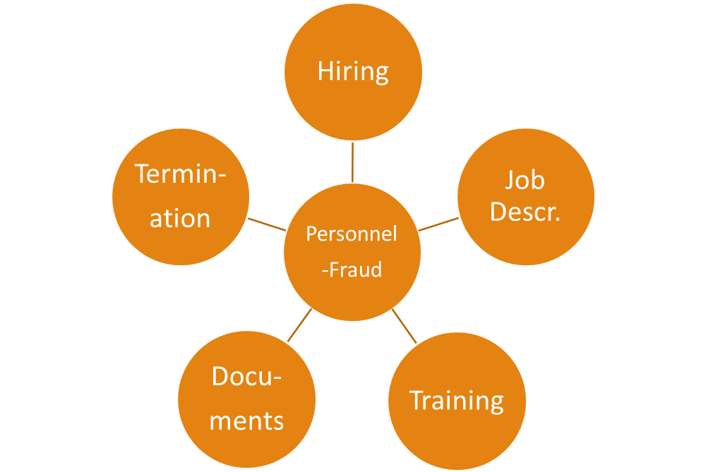
Security Issues with Personnel
Personnel are the weak link: Social Engineering: phishing, pharming, etc.
Issues to look at include:
Background checks
Skills mgmt.
Signed documents
Return equipment
Disable accounts
Segregation of Duties
Job descriptions
Need-to-know
Contracts
Policies/procedures
Config Mgmt.
Security awareness & training
Job skill training
Fraud reporting

Slide 4
Information Security Culture?
  = the human factor in information security
  Information security culture:
    emerges from employee behaviour in relation to information security - formal and informal
    can be broken down to:
      extent to which employees value the importance of security,
      how the culture promotes good security practices
      existence of a tradition for fostering security-minded thinking

Slide 5
The Aim
To foster behaviour where everyone does their part in:
  Considering security, business continuity and disaster recovery as part of their role
  Contributing towards new initiatives and reviews
  Preserving the goals of earlier security projects
Support these at the different levels that culture exists:
  Artifacts that are visible, e.g., locked doors, obvious firewalls, well displayed policies
  Values and norms, e.g., good communication, knowledge of policies, audit trails, consequences
  Tacit assumptions, e.g. , attitude, beliefs, awareness

Slide 6
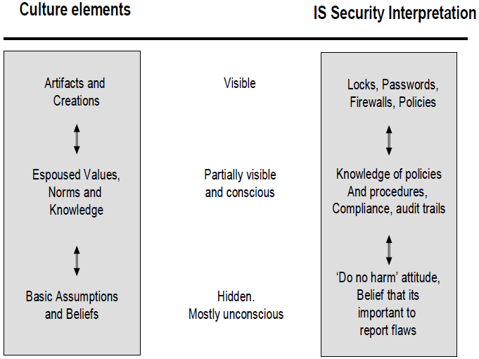
Culture & IS Security

Slide 7
Question
You are tasked with the challenge of educating all the IT users here at AUT on how to improve their security behaviour.
(i) What 5 things would you do? (include examples)
(ii) Chat to your neighbour and identify which 1 of the 5 would be most effective and describe why?

Slide 8
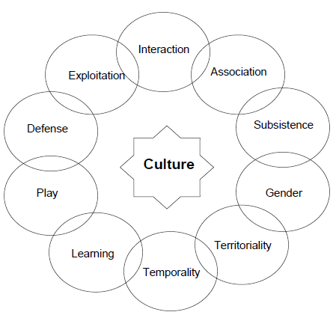
Nature of Culture
    Culture can be understood in terms of many subtle and silent messages
    Culture can be studied by analyzing the communication processes
    It can be said that culture is communication and communication is culture
    Ten streams of culture form a web of culture
    Dhillon, G. (2007). Principles of information system security: Texts and cases. Wiley, San Francisco: CA.

Slide 9
Social Engineering
Definition: The art and science of getting people to cooperate in the process of achieving your own goals. People hacking.
Threats: To build and maintain sound security systems, the social dimension – the human side – must also be considered.
Attacks on people are easier, require very little technology, and can be planned and implemented quickly.

Slide 10
Signs of a Social Engineering Attack
The attacker refuses to give contact information.
Urgency- The attacker shows signs of urgency and rushes through the process of communication after establishing an initial rapport.
Intimidation- There is a likelihood that if necessary, the attacker would resort to intimidate the prospective informant.
Minor errors in the attacker’s communication are common, for example, inserting an odd question into the communication.
Typically, the attack includes a request for forbidden information.

Slide 11
Countermeasures
1. Develop a comprehensive security policy, and revise when necessary. The security policy should be effectively communicated to employees, and enforced throughout the organization.
2. Create awareness of exposures to, and methods of, social engineering attacks.
3. Train and educate employees to be on the defense. Ongoing training programs serve as a constant reminders of social engineering threats, and how to identify and respond to them.
Notes:
Degaussing the process of decreasing or eliminating a remnant magnetic field

Slide 12
Increasing Awareness
Motivation and Attitude
  Performance depends on ability, motivation and working conditions
  Motivation is dynamic, Attitude is a more static, internalised factor
  Attitude relates mainly to the quality of actions
  Motivation correlates with activity levels:
  Fishbain and Ajzen (1975) suggest that there are two ways of producing change in human beliefs:
    Active participation
    Persuasive communication (p. 388).
    1. Belief, Attitude, Intention and Behaviour: An Introduction to Theory and Research (1975)

Slide 13
Increasing Awareness
  Davis (1989) suggested a Technology Acceptance Model (TAM), where systems use depends on behavioural intention to use, which implies attitude towards use, which is divided into:
    Perceived usefulness; and
    Perceived ease of use
  So…the consequences of following security guidelines must be desirable in the eyes of the users

Slide 14
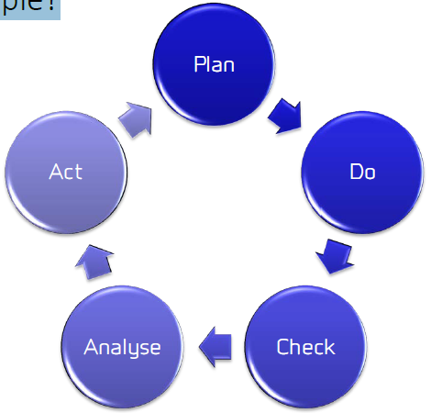
A World of Cycles?
Security management frameworks are often depicted as cyclical models…
Is life that simple?

Slide 15
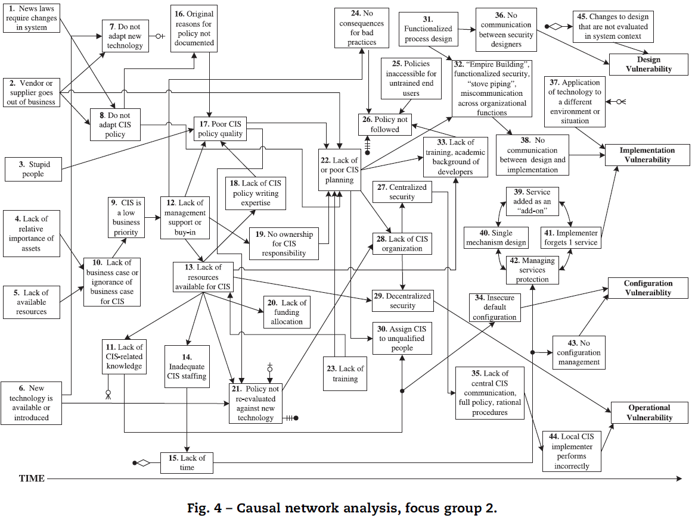
Do we really leave in a world of cycles?
Group background ¹: Computer science, nuclear weapons and materials research, distributed applications, UNIX systems, satellite sensor testing, process control systems, business administration, management, programming, quality assurance engineering, wireless security, intrusion detection, network security design, electrical engineering
¹ Human and organizational factors in computer and information security: Pathways to vulnerabilities, by Sara Kraemer et al.

Slide 17
Staffing the Information Security Function
INFORMATION SECURITY MANAGEMENT

Slide 18
Information Security Profession
Many Information Security professionals enter the field after careers in law enforcement or the military
  Or careers in other IT areas, such as networking, programming, database administration, management, or systems administration
  Organizations can foster greater professionalism
  By clearly defining their expectations and establishing explicit position descriptions rather than making it a sub-component of another role

Slide 19
Information Security Positions
  Types of Information Security Positions:
  Definers provide the policies, guidelines, and standards
    People who consult, do risk assessment and develop the product and technical architectures
    Senior people with a broad knowledge, but not a lot of depth
  Builders are the techies, who create and install security solutions
    Those that administer the security tools, the security monitoring function, and the people who continuously improve the processes
    Where all the day-to-day work is done
  Fixers are the trouble shooters and analysts who work to inform and improve the information security process

Slide 20
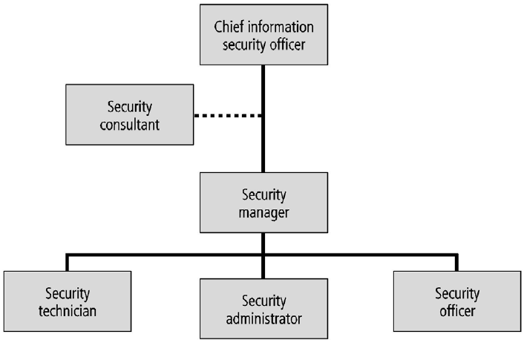
Objectives
To become familiar with the human factors in information security culture
To become aware of workflow based aspects of information security
To learn about the security practices used to control employee behavior and prevent misuse of information

Slide 21
Information Security Positions
  Chief Information Security Officer (CISO)
  Typically considered the top information security officer in the organization
    Usually not an executive-level position
    Frequently reports to the CIO and at the executive-level
  Business managers first and technologists second
  They must be conversant in all areas of information security including technology, planning, and policy and understand business processes

Slide 22
Information Security Positions
  Certified Information Systems Security Professional (CISSP)
    Most common qualification for the CISO
  Often a postgraduate degree in criminal justice, IS, business, technology, or another related field is usually typical for the CISO
  CISO candidates typically have experience in security management, planning, policy, and budgeting

Slide 23
Information Security Positions
  Security Manager
  It is not uncommon for a security manager to have a CISSP or similar
  Should have experience in traditional business activities, including budgeting, project management, personnel management, staffing
  Must be able to draft middle and lower-level policies, as well as incorporate standards and guidelines
  Several types exist, and the roles tend to be much more specialized than CISOs

Slide 24
Information Security Positions
Security Technician/Analyst
  Technically qualified individuals who configure firewalls and intrusion detection systems, implement security software, diagnose and troubleshoot problems, and coordinate with systems and network administrators to ensure that security technology is properly implemented
  Typical information security entry-level position, albeit often a highly technical one

Slide 25
Information Security Positions
  Technical qualifications and position requirements for a security technician vary
  Organizations typically prefer expert, certified, proficient technicians
  Job requirements usually include some level of experience with a particular hardware and software packages
    Experience using the technology is usually required

Slide 26
Security Professional Credentials
  Many organizations rely on professional certifications:
    To ascertain the level of proficiency possessed by any given candidate
    Many certification programs are relatively new
    Their precise value is not typically fully understood by most hiring organizations
  Certifying bodies work to educate their constituent communities on the value and qualifications of their certificate recipients

Slide 27
Security Professional Credentials
  Two current challenges for certification in practice:
  Employers can often struggle to match certifications to position requirements
  Potential information security workers try to determine which certification programs will help them in the job market

Slide 28
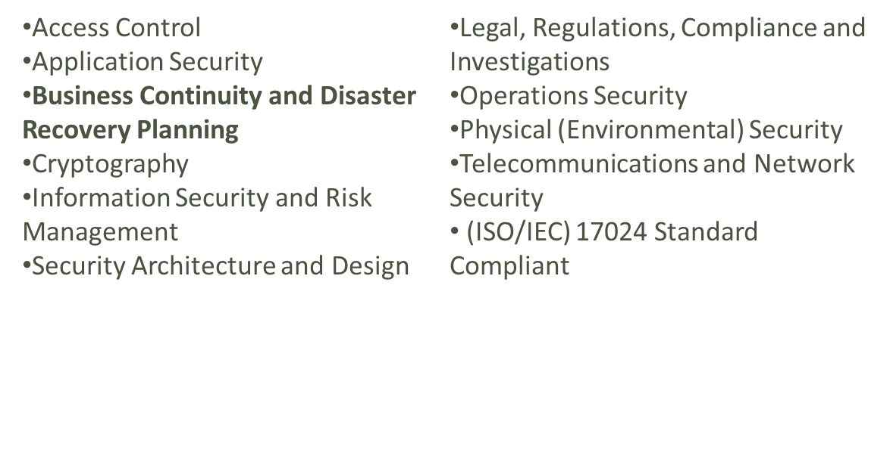
(ISC)² Certification
Certified Information Systems Security Professional
  One of the most prestigious certifications
  Recognizes mastery of domains of an internationally recognized InfoSec common body of knowledge:
    International Information Systems Security Certification Consortium, Inc., (ISC)²

Slide 29
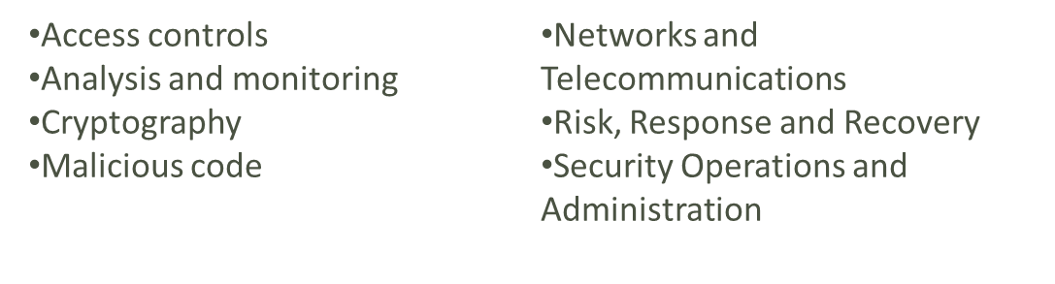
(ISC)² Certification
Systems Security Certified Practitioner
  More applicable to an entry-level security manager than a technician
  Most questions focus on operational InfoSec
  Focuses on practices, roles, and responsibilities covering seven domains:

Slide 30
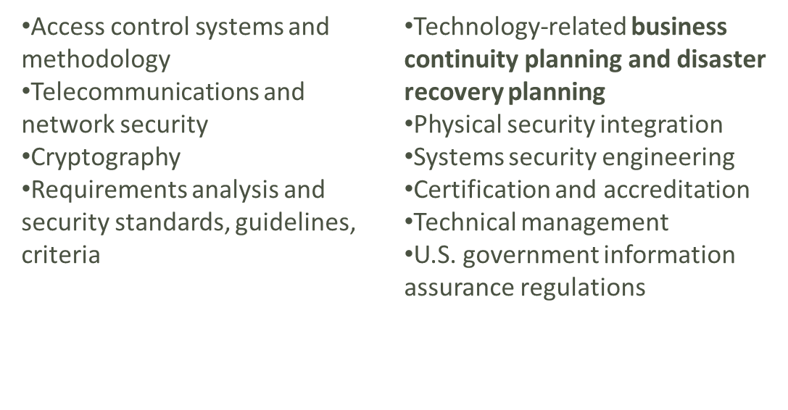
(ISC)² Certification
ISSAP®: Information Systems Security Architecture Professional
  Architecture-focused

Slide 31
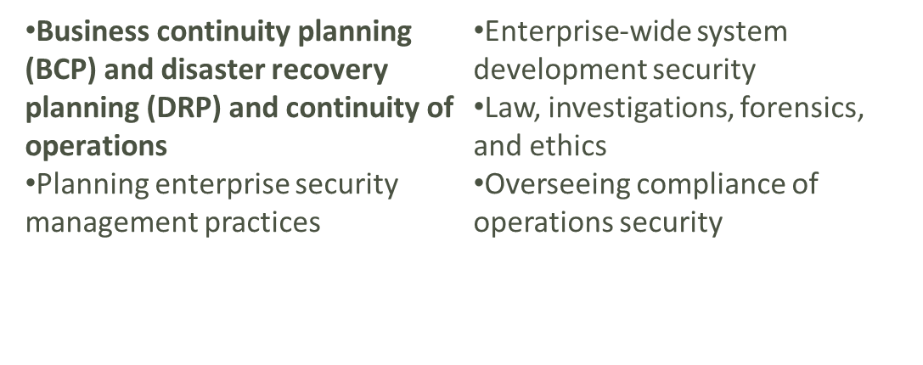
(ISC)² Certification
ISSMP®: Information Systems Security Management Professional

Slide 32
ISACA¹ Certifications
Certified Information Systems Auditor (CISA)
  A certification of the Information Systems Audit and Control Association and Foundation (ISACA)
  Appropriate for auditing, networking, and security professionals
  Exam covers:
    IS audit process (10%)
    IT governance (15%)
    Systems and infrastructure life cycle (16%)
    IT service delivery and support (14%)
    Protection of information assets (31%)
    Business continuity and disaster recovery (14%)
    1. Information Systems Audit and Control Association

Slide 33
ISACA¹ Certifications
Certified Information Security Manager (CISM)
  Geared toward experienced information security managers
  Assures executive management that a candidate has the required background knowledge needed for effective security management and consulting
  Exam covers:
    Information security governance (23%)
    Information risk management (22%)
    Information security program development (17%)
    Information security program management (24%)
    Incident management and response (14%)
    1. Information Systems Audit and Control Association

Slide 34
GIAC¹ Certification
System Administration, Networking and Security (SANS) Institute
  Developed a series of technical security certifications known as the GIAC
  The GIAC family of certifications can be pursued independently
    Or combined to earn a comprehensive certification called GIAC Security Engineer (GSE), at a silver, gold or platinum level
Other SANS certifications:
  Security Professional (GISP)
  GIAC Security Leadership Certification (GSLC)
    1. Global Information Assurance Certification (GIAC)

Slide 35
GIAC¹ Certification
GIAC Certifications:
  Information Security Fundamentals (GISF)
  Security Essentials Certification (GSEC)
  Certified Firewall Analyst (GCFW)
  Certified Intrusion Analyst (GCIA)
  Certified Incident Handler (GCIH)
  Certified Windows Security Administrator (GCWN)
  Certified Unix Security Administrator (GCUX)
  Certified Forensics Analyst (GCFA)
    1. Global Information Assurance Certification (GIAC)

Slide 36
GIAC¹ Certification
GIAC Certifications:
  Securing Oracle Certification (GSOC)
  Intrusion Prevention (GIPS)
  Cutting Edge Hacking Techniques (GHTQ)
  Web Application Security (GWAS)
  Reverse Engineering Malware (GREM)
  Assessing Wireless Networks (GAWN)
  Course Map:
  www.sans.org/media/security-training/map.php
  +Prep training programmes
    1. Global Information Assurance Certification (GIAC)

Slide 37
CompTIA Security+
The CompTIA Security+ certification:
  Tests for security knowledge mastery
  Must have two years of on-the-job networking experience with emphasis on security
  Exam covers industry-wide topics including:
    Systems security (21%)
    Network infrastructure (20%)
    Access control (17%)
    Assessments & audits (15%)
    Cryptography (15%)
    Organizational Security (12%)
    CompTIA

Slide 38
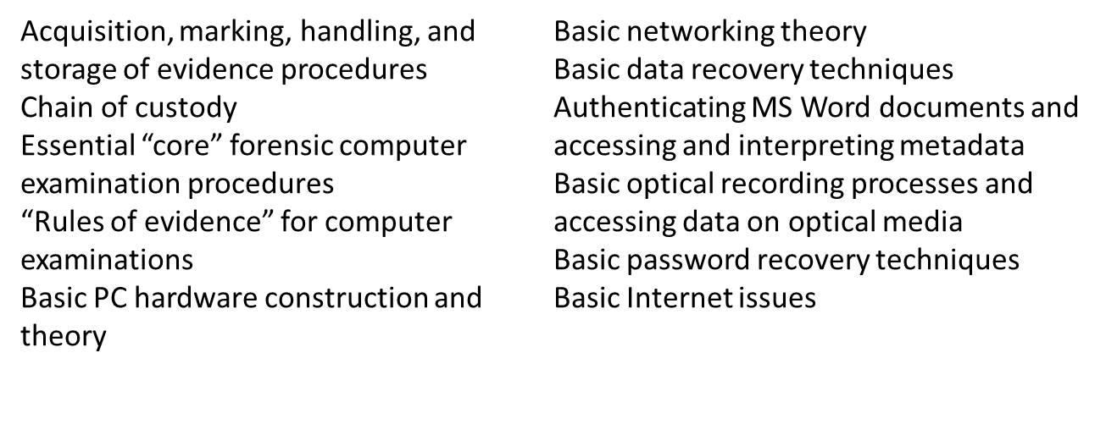
Certified Computer Examiner (CCE)
An IT Forensics certification offered by the International Society of Forensic Computer Examiners
  Topics include:
    The International Society of Forensic Computer Examiners

Slide 39
Certification Costs
Preferred certifications can be expensive (CISSP USD3,795 +599)
Most experienced professionals find it difficult to do well on the exams without at least some review *(take the course)
Certifications recognize experts in their respective fields
  The cost of certification deters those who might otherwise take the exam just to see if they can pass
Most examinations:
  Require between one and three years of work experience
  They are often structured to reward candidates who have significant hands-on experience

Slide 40
Security Roles Summary
Chief Information Security Officer
Data Owner, Process Owner: Allocates permissions, defines safe processes.
Info Security Steering Committee: Management with knowledge of business and/or security functions defines security
Incident Response Management/Team: Decides or performs functions related to incident response.
Security Analyst, Security Administrator: Security staff to design or implement security functions.

Slide 41

Personnel Issues
HIRING
CONTRACTS
TERMINATION

Slide 42
Hiring
From an information security perspective, hiring employees is laden with potential security pitfalls and obstacles
Information security considerations should become part of the hiring process
Job descriptions
  Provide complete job descriptions when advertising open positions
    Omit the elements of the job description that describe access privileges

Slide 43
Hiring
Interviews:
  Information Security should advise Human Resources/People & Organisation/Recruiting
    Limit the information provided to the candidates on the access rights of the position
When an interview includes a site visit:
  Tour should avoid secure and restricted sites, because the visitor could observe enough information about the operations or information security functions to represent a potential threat to the organization

Slide 44
Hiring
  New Hire Orientation (Induction)
    New employees should receive an information security briefing as part of their orientation or induction
  On-the-job security training
    Conduct Security Education Training and Awareness (SETA) activities periodically
    Keeps security at the forefront of employees’ minds and minimizes employee mistakes (builds the culture)
  Security checks
    Conduct a background check before extending an offer

Slide 45
Hiring
Common background checks
  Identity checks: personal identity validation
  Education and credential checks: institutions attended, degrees and certifications earned, and certification status
  Previous employment verification: where candidates worked, why they left, what they did, and for how long
  Reference checks: validity of references and integrity of reference sources
  Worker’s compensation history: claims
  Drug history: drug screening and drug usage, past and present

Slide 46
Hiring
  Motor vehicle records: driving records, suspensions, and other items noted in the applicant’s public record
  Medical history: current and previous medical conditions, usually associated with physical capability to perform the work in the specified position
  Credit history: credit problems, financial problems, and bankruptcy
  Civil court history: involvement as the plaintiff or defendant in civil suits
  Criminal court history: criminal background, arrests, convictions, and time served

Slide 47
Contracts and Employment
Once a candidate has accepted a job offer:
  The employment contract becomes an important security instrument
  It is important to have these contracts and agreements in place at the time of the hire
  Don’t let anyone in without their signature on an employment contract

Slide 48
Security as Part of Performance Evaluation
Organizations can incorporate information security components into employee performance evaluations
  To heighten information security awareness and change workplace behavior
  Employees will pay closer attention to job performance evaluations
  Including information security tasks in them will motivate employees to take more care when performing these tasks

Slide 49
Employee Termination
When an employee leaves an organization, the following tasks should be performed:
  Disable access to the organization’s systems
  Return all removable media and devices
  Hard drives must be secured
  File cabinet and door locks must be changed
  Keycard access must be revoked
  Personal effects must be removed
  Escort the former employee from the premises

Slide 50
Employee Termination
Many organizations conduct an exit interview
  To remind the employee of any contractual obligations such as nondisclosure agreements
  To obtain feedback on the employee’s tenure in the organization
Let’s look at methods for handling employee out-bound processing; both hostile and friendly

Slide 51
Employee Termination
Hostile departure
  At all times follow your organisation’s procedures
  Security cuts off all logical and keycard access before the employee is terminated (notification must be given)
  The employee reports for work, and is escorted into the supervisor’s office to receive the summary dismissal
  The individual may then be escorted from the workplace and informed that his or her personal property will be forwarded, or is escorted to his or her office, cubicle, or personal area to collect personal effects
  Get advice and involve HR so that at all times you are following your organisation’s procedures – especially for approvals

Slide 52
Employee Termination
Hostile departure
  Once personal property has been gathered, the employee is asked to surrender all keys, keycards, and other organizational identification and access devices, PDAs, Tablets, pagers, cell phones, and all remaining company property
    Then escorted from the building
    Follow up to make sure that access devices are disabled (test them)
    Follow up to ensure that other employees are aware of the situation and that clearance and access is no longer authorised

Slide 53
Employee Termination
Friendly departure
  The employee may have tendered notice well in advance of the actual departure date
  Difficult for security to maintain positive control over the employee’s access and information usage
  Employee accounts are usually allowed to continue, with a new expiration date
  The employee can come and go at will
  Usually collects any belongings and leaves without escort, dropping off all organizational property before departing

Slide 54
Employee Termination
In either circumstance:
  Offices and information used by departing employees must be inventoried, their files stored or destroyed, and all property returned to organizational stores
  Departing employees may have collected and taken home information or assets that could be valuable in their future jobs
  Scrutinizing system logs may allow an organization to determine whether a breach of policy or a loss of information has occurred

Slide 55
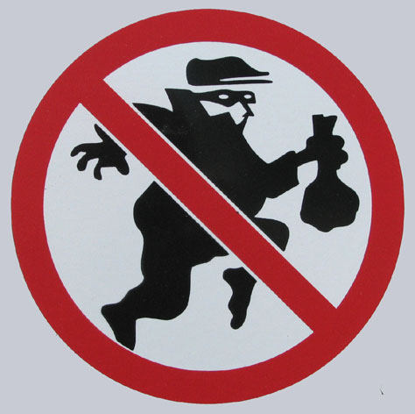
Personnel-Fraud Issues
SEGREGATION OF DUTIES
DOCUMENTATION:
CONFIGURATION MANAGEMENT
CHANGE CONTROL
TRAINING

Slide 56
Workbook: Personnel Security
Personnel Threats
Threat | Role | Liability or Cost if threat occurs
Divulging private info | Employee | FERPA violation = loss of federal funds
Skim payment cards | Salesperson | PCI DSS, state breach violation
Grant abuse | Employee with grant | Loss of funds from US granting agencies
Abuse of student | Employee, student, visitor | Bad press – loss in reputation May incite lawsuit
Notes:
The next Workbook slides show the method used to develop personnel security

Slide 57
Fraud Control Types
Time of
Fraud
After Fraud
Before Fraud:
***BEST***
Corrective
Controls:
Punishment->
Amend controls
Fidelity Insurance
Employee Bonding
Detective Controls:
Finding fraud when it occurs includes:
Anonymous hotline*->
Surprise audits*->
Monitoring activities->
Logged transactions
Employee badges
Complaint or fraud
investigation
Mandatory vacations
Job rotation
Preventive Controls**:
Preventing fraud includes:
Segregation of Duties
Security roles
Ethical culture
Internal controls:
Physical & data security
Need-to-know
Signed documents
Fraud, security awareness training
Employee Support Programs
Background checks
Notes:
The three types of security controls include Preventive, Detective, and Corrective. They relate to when the fraud was found.
Preventive Controls are most important, because the fraud does not occur in the first place. Thus it is better than detecting or correcting fraud (and fraud is rarely corrected anyway.)
*Anonymous hotline finds the most fraud, and internal audits (surprise audit) is the third leading cause of finding fraud. Some Detective and Corrective Controls also serve as Preventive Controls, as indicated by arrows ->.

Slide 58
Personnel Security Practices
Methods of monitoring and controlling employees
  To minimize their opportunities to misuse information
  Separation of duties is used to make it difficult for a single individual to violate information security and breach the confidentiality, integrity, or availability of information
  Two-person controls require that two individuals review and approve each other’s work before the task is considered complete

Slide 59
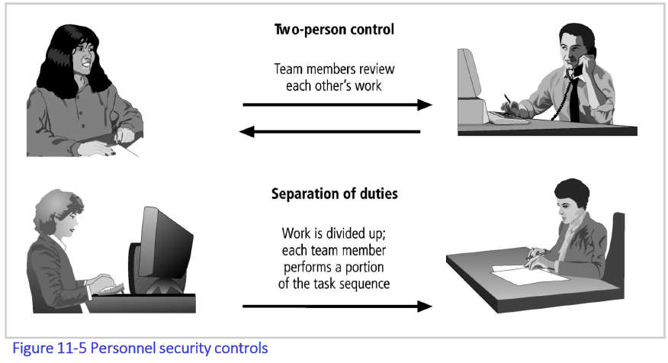
Personnel Security Practices
Organizations should incorporate information security components into employee performance evaluations
  To heighten information security awareness and change workplace behavior
  Employees will pay closer attention to job performance evaluations
    Including information security tasks in them will motivate employees to take more care when performing these tasks

Slide 60




Segregation of Duties
Authorization
Distribution
Approves
Acts on
Double-checks
Origination
Verification
Notes:
No one person can deliver service and take money with the potential of stealing or falsifying sales.
Consider a Movie Theater:
Origination: The person who sells you the ticket
Distribution: The person who lets you into the theater.
Authorization: Ticket sales of a certain unusually large amount may require manager approval
Verification: Was this done correctly?
Authorization: Someone charges on VISA. VISA validates that yes, this VISA account is good.

Slide 61
Organizational
Segregation of Duties
Audit
Ensures procedures are professionally done
Security/
Compliance
Quality
Control
advises &
monitors for
security
tests or ensures
quality of S/W or
production
Business
System/
Network
Admin
Development
serves
delivers
S/W to
advises
Notes:
Development only delivers S/W to System Administration when QC has approved
Compliance: tracks security issues, such as metrics or violations of procedures, and resolves security issues

Slide 62


IT Segregation of Duties
User
End User
Data Entry
Test Environment
Quality Assurance
Requirements/Design
Systems Analyst
Database Administrator
Security
Control Group
Security Admin
Production Environment
Computer Operator
System Administrator
Network Administrator
Help Desk
Development
Environment:
Application programmer
Systems programmer
Notes:
The full and partial walls indicate where functionality can, should not, or cannot overlap. Do note that development environment should not overlap with production environment: programmers should not become system administrators. In previous slide terms, Originators should not become Distributers. Security admin can do some system admin work, but there are advantages for these groups to have separate functions: since security serves to Authorize or Verify whereas system administration serves as Distribution. Quality Assurance serves to Authorize or Verify what Development Originates. This shown diagram is not as complete as the table in the CISA manual.

Slide 63
Segregation of Duties Controls
Transaction Authorization
Asset inventory & custody
Data owner’s responsibility is specific and documented
  Allocates authorization according to least-privilege and segregation of duties
Security Administrator implements physical, system & application security
  Authorization forms
  User authorization tables: who can view/update/delete data at transaction or field level
Notes:
A Data Owner is a person who can give out accounts for a specific (database) service. They are usually a business manager.
Security administrator is someone in IT or IT security. They have a high level of permissions on a computer.

Slide 64
Tools to Control Documents:
Configuration Management
Central repository = electronic library document management system.
Retains Important documents
Software development teams: requirements, design , test documents, and program code
Project, audit and security plans.
Maintains history: holds a snapshot of different versions for each document,
Any version can be retrieved at any time.
Permits users to:
checkout a document;
edit, review or approve the document; and
check it in with increased version #.
The reason for revision and author is recorded and later available as version history.

Slide 65
Tools to Control Documents:
Change Management
Change management helps to create different configuration management versions.
Maintains state of a change proposal:
Starts with a Change Request may be
analyzed and approved by management for implementation. The change is then
implemented (e.g., programmed or acted upon) and then
tested and approved, when the change is ready for deployment.
Documentation for each of these stages is maintained in a change management or configuration management repository,
Emails may notify stakeholders of changes of status.

Slide 66
Personnel Security Practices
  Job rotation is another control used to prevent personnel from misusing information assets
    Requires that every employee be able to perform the work of at least one other employee
  Task rotation is where all critical tasks can be performed by multiple individuals and are periodically rotated

Slide 67
Personnel Security Practices
Job rotation and task rotation ensure
  No one employee is performing actions that cannot be knowledgeably reviewed by another employee
  Each employee should be required to take mandatory vacation
  This policy gives the organization a chance to perform a detailed review of everyone’s work

Slide 68
Personnel Security Practices
Limiting access to information:
  Minimizes opportunities for employee misuse
  Employees should be able to access only the information they need, and only for the period required to perform their tasks
  This idea is referred to as the principle of least privilege
    Ensures that no unnecessary access to data occurs
    If all employees can access all the organization’s data all the time, it is almost certain that abuses will occur

Slide 69
Personnel and Personal Data
Organizations are required by law to protect sensitive or personal employee information too
  Examples: employee addresses, phone numbers, tax numbers, medical conditions, and names and addresses of family members
  Responsibility extends to customers, patients, partners, suppliers, and anyone with whom the organization has business relationships

Slide 70
Personnel and Personal Data
Personnel data is no different than other data that information security is expected to protect
  But more regulations cover its protection
Information security procedures should ensure that this data receives at least the same level of protection as the other important data in the organization

Slide 71
Non-Employees
Many individuals who are not employees often have access to sensitive organizational information
  Individuals in this category should be carefully managed to prevent threats to information assets from materializing
Casual and temporary workers
  Not employed by the organization for which they’re working
  May not be subject to the contractual obligations or policies that govern employees
  Unless specified in contract with the organization, the temporary agency may not be liable for losses caused by its workers
  Access to information should be limited to what is necessary to perform their duties (again as the principle of least privilege)

Slide 72
Non-Employees
Contract employees
  Professional contractors may require access to all areas of the organization to do their jobs
  Service contractors usually need access only to specific facilities
    Should not be allowed to wander freely
  In a secure facility, all service contractors are escorted from room to room, and into and out of the facility
  What about the cleaners?

Slide 73
Non-Employees
Some regulations for service agreements or contracts:
  Require 24 to 48 hours’ notice of a maintenance visit
  Require all on-site personnel to undergo background checks
  Require advance notice for cancellation or rescheduling of a maintenance visit
  Approval process required for exceptions

Slide 74
Non-Employees
Consultants
  Have their own security requirements and contractual obligations
    Should be handled like contract employees
  Special requirements, such as information or facility access requirements, should be integrated into the contract before facility access is granted
  Protecting your information may not be their number one priority
  Apply the principle of least privilege

Slide 75
Non-Employees
Strategic or Business partners
  Strategic alliances with other organizations to exchange information, integrate systems, or enjoy some other mutual advantage
  A prior agreement must specify the levels of exposure that both organizations are willing to tolerate
  Security and technology consultants should be pre-screened, escorted, and subjected to nondisclosure agreements

Slide 76
Non-Employees
Strategic or Business partners
  If the strategic partnership evolves into an integration of the systems of both companies
    Competing groups may be provided with information that neither parent organization expected
    Nondisclosure agreements are an important part of any such collaborative effort
  Security level of both systems must be examined before any physical integration takes place
    A vulnerability on one system becomes vulnerability for all linked systems

Slide 77

Security Awareness & Training
Training covers what is expected of employees
  Why is policy in place?
  How is policy enforced?
Training may be implemented as:
  New employee orientation
  Company newsletters
  Determine effectiveness by interviewing employees

Slide 78
Awareness Function:
Types of Security Training
Awareness: Create security-conscious workforce | Employees, partners & vendors | Newsletters, surveys, quizzes, video training, forums, posters
Training: Necessary skills for a particular position | HR, legal, middle or top mgmt, IT, programmers | Workshops, conferences
Education: High level skills | High-skilled professions: audit, security admin/mgmt, Risk mgmt… | Organized and gradual development: teaching & coaching
Notes:
Left column: level of security training
Middle column: intended audience
Right column: appropriate methods

Slide 79
Awareness Training
Signed employment agreements, video, memos, emails, posters, seminars and training classes
A combination of parallel approaches
Knowledge areas:
  Back-up work-related files
  Choosing passwords and avoiding exposure
  Avoiding email and web viruses
  Recognizing social engineers
  Recognizing & reporting security incidents
  Securing electronic & paper media against theft & exposure
  Spotting malware that could lead to identity theft & desktop spying
Metrics should be established to determine effectiveness of change in behavior and workforce attitude

Slide 80
Other Personnel Preventive Controls
Training and written policies and procedures
Ethical Culture: Mgmt must live, mentor, insist on ethical behavior.
Employee Support Programs: Addresses personal/financial problems before they are unmanageable.
Background checks: For handlers of PII.
Need to Know/Least Privilege

Slide 81
Detective & Corrective Controls
DETECTIVE/DETERRENCE CONTROLS
CORRECTIVE CONTROLS
Fraud reporting or hotline
Logged transactions
Internal Audit Dept and Surprise Audits
Mandatory vacations or job rotation.
Employee Bonding: Insurance protects against losses due to theft, mistakes and neglect.
Fidelity Insurance: Insurance against fraud or employee misdeeds is useful for rare but expensive risks

Slide 82
Summary
  Introduction to Culture & IS Security
  Staffing the security function
    Information security professional credentials
    Employment policies and practices

